Slide 1
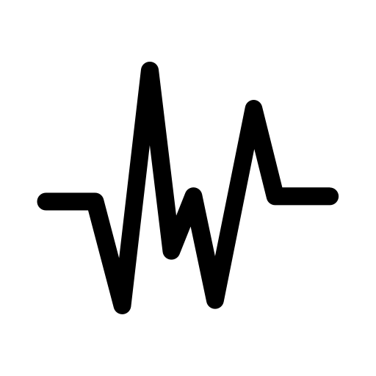




ECG data-based
Blood Pressure Estimation
MENTOR: DR BINOD KUMAR
Presentation By: Rishav Kumar(B19ME066)

Slide 2
01.
Design Problem FORMULATION
ECG

Slide 3
DESIGN PROBLEM
TASK 1
Our prime objective in this project is to estimate Blood Pressure (BP), Systolic Blood Pressure (SBP) and Diastolic Blood Pressure (DBP), values based on Electrocardiograph (ECG) data. We must classify the blood pressure reading into three groups (Normal, Prehypertension, and Hypertension) using the SBP and DBP values shown in the table below.
Category | SBP (mm Hg) | Operator | DBP (mm Hg)
Normal | <= 90 >= 90 and < 120 | OR AND | <= 60 >= 60 and < 79
Prehypertension | >= 120 and < 140 | OR | >= 80 and < 90
Hypertension | >= 140 and < 160 >= 160 >= 140 >= 180 | OR OR AND OR | >= 90 and < 100 >= 100 < 90 >= 110

Slide 4
DESIGN PROBLEM
TASK 2
Another team has worked on the classification task, which entails classifying data into normal, prehypertension, and hypertension classes using Machine Learning (ML). Assuming this team achieves 100% accuracy, we must expand on this work and develop individual models for the three classes in order to predict blood pressure. The SBP and DBP values of the patient must be passed via the classification model if it has predicted that they fall into a particular class.

Slide 5
ML-based methodology for BP prediction
Documentation and report
Targeted Deliverables

Slide 6
02.
Methodology
Adopted

Slide 7
DATA-set
CHOSEN DATA-SET
Open-source version of the Multi-Parameter Intelligent Monitoring in Intensive Care (MIMIC-II) waveform data-set from Physionet
Thousands of signals from 942 ICU patients hospitalized between 2001 and 2008
Transmissions have a 125 Hz sampling rate
Data set's synchronous Aorta Blood Pressure (ABP), ECG, and Photoplethysmograph (PPG) signals have been smoothed using a basic averaging filter
Signals with jarring discontinuities or unacceptably high heart rates have been eliminated
Signal blocks that displayed a significant change, those with inappropriate human blood pressure readings were also removed

Slide 8
DATA PREPROCESSING
PREPROCESSING OF DATA
Signals are then divided into samples of 4 seconds each, resulting in an array of length 500 for each sample
Second order bandpass butterworth filter with corner frequencies of 0.1 Hz and 50 Hz is used to filter the four-second ECG data
To ensure that the signal does not lose any information, the sampling rate is at least 50 Hz.
R-peak value is determined using the built-in library neuronkit2 after the signal has been filtered.
4-second signals with less than four R-peaks are eliminated, and these R-peak locations are kept
Signals with discontinuities are removed

Slide 9
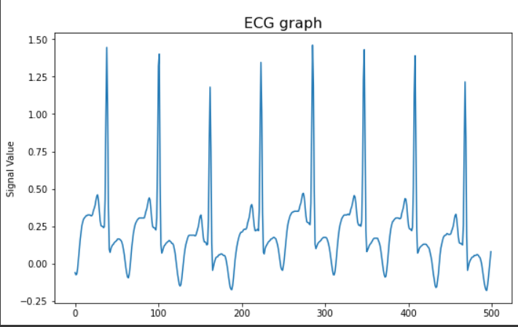
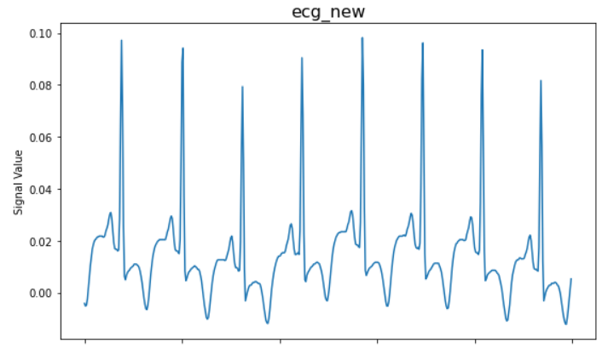
DATA PREPROCESSING
PREPROCESSING OF DATA
Filtered ECG 4 second signal
Original ECG 4 second signal

Slide 10
DATA PREPROCESSING
PREPROCESSING OF DATA
Each signal segment now comprises of the ECG signal in between four consecutive R-peaks
The new signal array we got now has a length that can be anywhere between 117 and 450, we must decide on a definite length for the array; in this example, we have chosen the signal length to be 120 samples
We must resample each segment to a length of 120 by obtaining the Fast Fourier Transform (FFT), since some samples of the four R-peak signal are larger than that and others are smaller

Slide 11
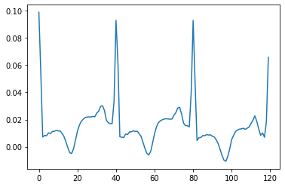
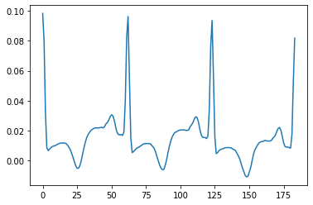
DATA PREPROCESSING
PREPROCESSING OF DATA
After resampling
Before Resampling

Slide 12
Possible Methods
METHOD 1
a) Non-uniform Data:
Using an Adaboost regressor:
Data is directly trained using the Adaboost regression algorithm
Train-test split with a test size of 0.33 is used to separate the dataset into training and validation sets
Received individualised training for both SBP and DBP
K fold cross validation (K = 5) is used to identify problems like overfitting or selection bias and to provide information on how the model will generalise to an independent dataset
Determined the Root Mean Squared error (RMSE) at each fold as well as the average RMSE value

Slide 13
Possible Methods
METHOD 1
B. Using an ANN-based regressor:
Data is directly trained using the ANN-based regression algorithm
Train-test split with a test size of 0.33 is used to separate the dataset into training and validation sets
Received individualised training for both SBP and DBP
Model used is a sequential model with three hidden layers made up of 1024, 512, and 64 neurons
Each layer uses a different dropout of 0.5, 0.5, and 0.25
Employed an activation function for the hidden layer of the Relu and Adam Optimizer (Learning Rate = 0.01)
Determined the neural net RMSE value

Slide 14
Possible Methods
METHOD 1
b) Uniform Data:
We trained both the Adaboost and ANN models using the same procedure and parameters, but we also performed additional data preprocessing before training the models
Examined the separation between adjacent R peak values and estimated the typical separation
Deleted a data point if the separation between them is more than +-10% of the typical separation

Slide 15
Possible Methods
METHOD 2
Model is trained separately for three classes, for both SBP and DBP
The classification problem, which involves applying ML to divide data into classifications for normal, prehypertension, and hypertension, has been worked on by another team
We must build on this work and create unique models for the three classes in order to predict blood pressure, assuming this team achieves 100% accuracy
If the classification model predicts that the patient belongs to a specific class, the SBP and DBP readings of the patient must be passed through it
We categorised the data after the preprocessing work and we obtained three different datasets
Using the same settings as before, we applied the Adaboost and ANN models to this dataset.

Slide 16
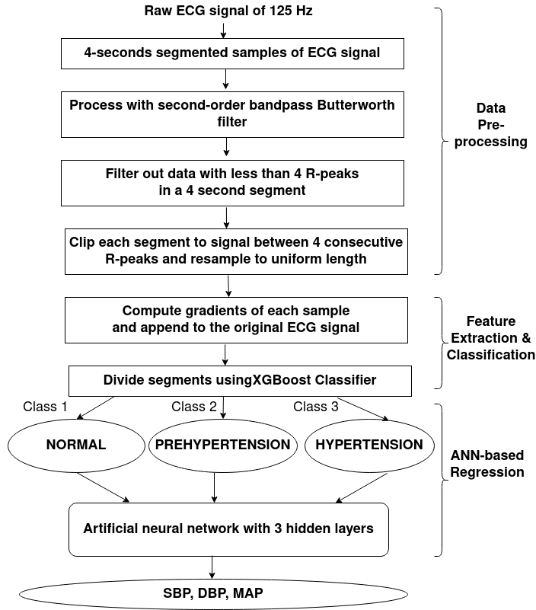

Slide 17
03.
RESULTs And ANALYSIS
BP

Slide 18
RESULTS
METHOD 1
Data | Regressor | RMSE (SBP) | RMSE (DBP)
Non-uniform | Adaboost | 19.70789982236872 | 21.570187087585726
Non-uniform | ANN | 15.186525424780317 | 9.09528037081269
Uniform | Adaboost | 19.666706219209686 | 14.26789541173926
Uniform | ANN | 12.757742688569234 | 6.338174902260865

Slide 19
RESULTS
METHOD 2
Regressor | Class | RMSE (SBP) | RMSE (DBP)
Adaboost | Normal | 18.144848787869638 | 6.71007001446061
Adaboost | Prehypertension | 16.263392699571902 | 15.455149841896423
Adaboost | Hypertension | 13.370559769713472 | 24.97219942291945
ANN | Normal | 12.465272120081679 | 4.676271347181978
ANN | Prehypertension | 10.745985247730248 | 8.13407420841933
ANN | Hypertension | 11.185960777543254 | 8.85719609788793

Slide 20
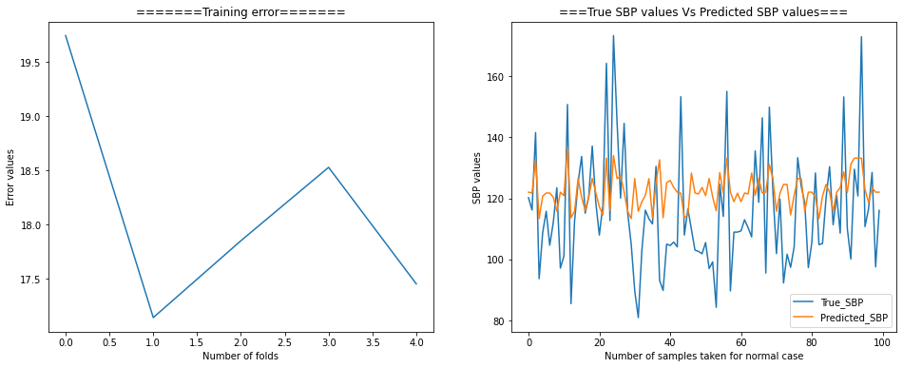
RESULTS
METHOD 2
Adaboost Regressor for Normal Class

Slide 21
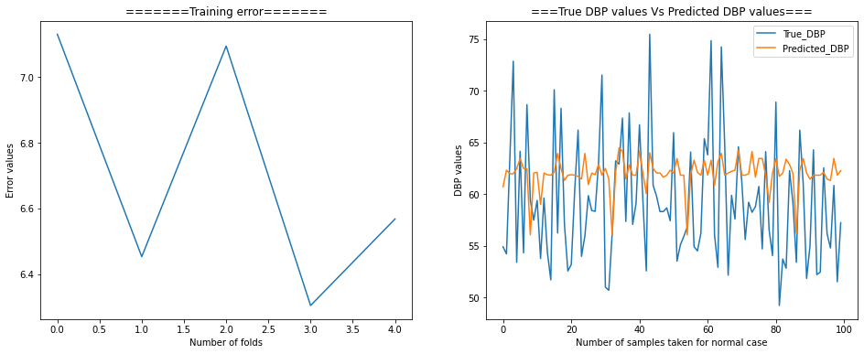
RESULTS
METHOD 2
Adaboost Regressor for Normal Class

Slide 22
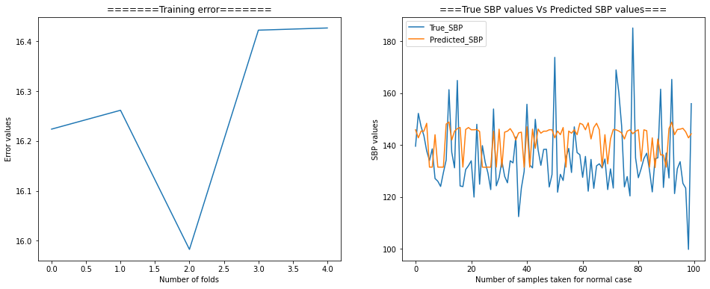
RESULTS
METHOD 2
Adaboost Regressor for Prehypertension Class

Slide 23
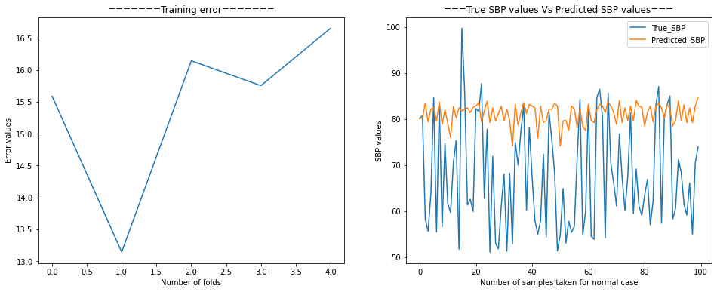
RESULTS
METHOD 2
Adaboost Regressor for Prehypertension Class

Slide 24
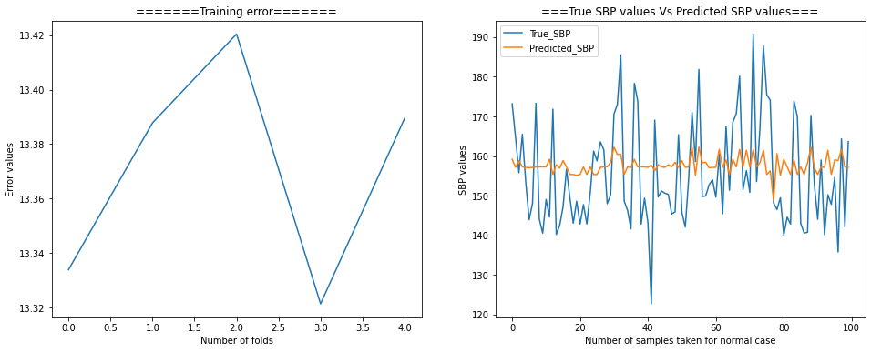
RESULTS
METHOD 2
Adaboost Regressor for Hypertension Class

Slide 25
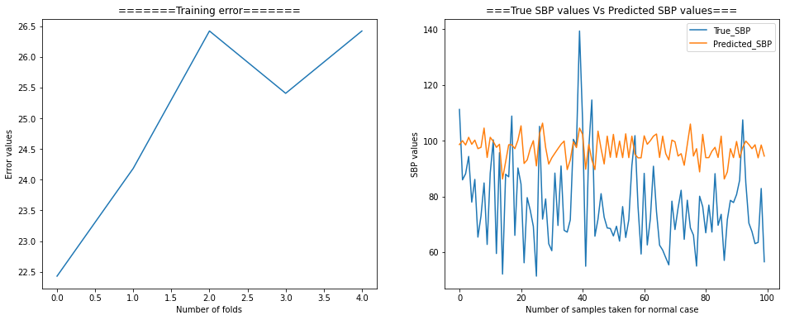
RESULTS
METHOD 2
Adaboost Regressor for Hypertension Class

Slide 26
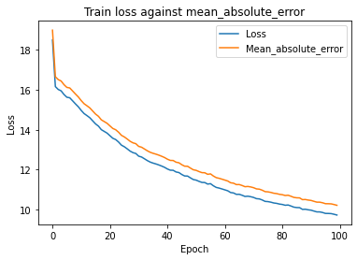
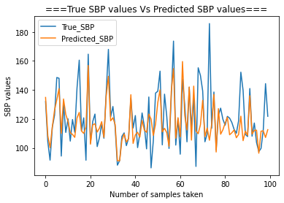
RESULTS
METHOD 2
ANN-based Regressor for Normal Class

Slide 27
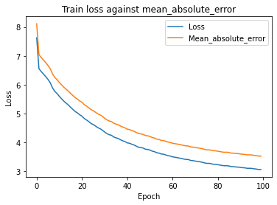
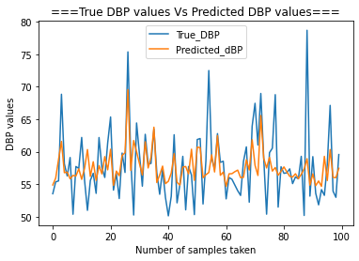
RESULTS
METHOD 2
ANN-based Regressor for Normal Class

Slide 28
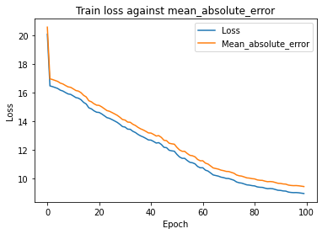
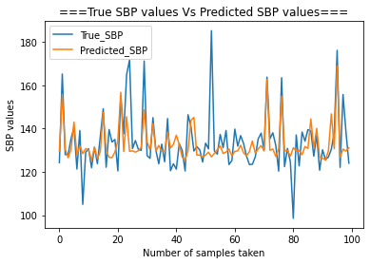
RESULTS
METHOD 2
ANN-based Regressor for Prehypertension Class

Slide 29
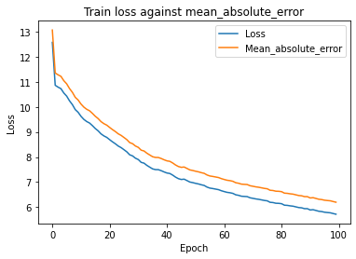
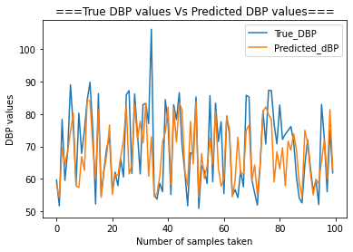
RESULTS
METHOD 2
ANN-based Regressor for Prehypertension Class

Slide 30
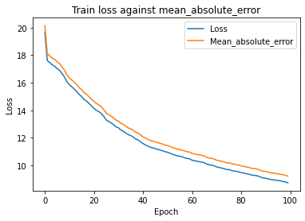
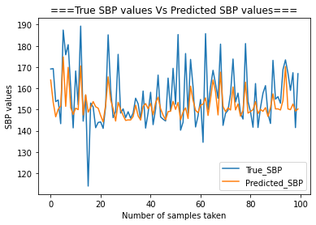
RESULTS
METHOD 2
ANN-based Regressor for Hypertension Class

Slide 31
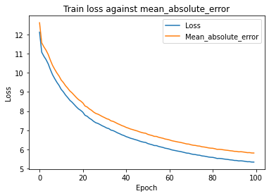
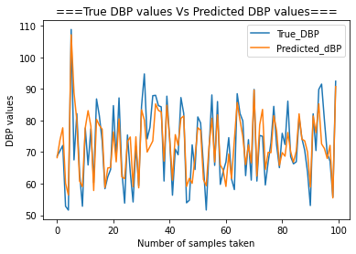
RESULTS
METHOD 2
ANN-based Regressor for Hypertension Class

Slide 32
THANKS!

